Slide 1
Physics in the Nature Park
Investigating surface temperatures in school grounds

Slide 2
Learning outcomes
observe temperature variations across an outdoor area on a sunny day
compare observed data with predictions
prepare for future Physics topics on electromagnetic spectrum, specific heat capacity, latent heat, energy transfer and the greenhouse effect

Slide 3
Predictions
Where in the school grounds do you predict will be hottest?
Where in the school grounds do you predict will be coolest?
Why have you made these predictions?

Slide 4

Infra-red scale
What does the scale show?
Highest surface temperature
Lowest surface temperature​
White indicates the highest surface temperature in a frame and dark blue the lowest.

Slide 5
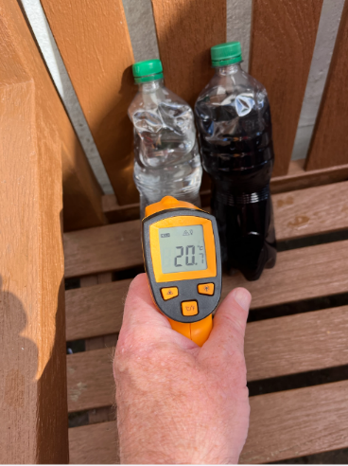
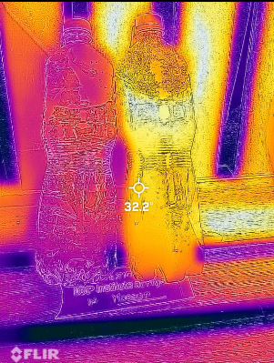
Water and dye prediction
These bottles have been left in strong sunlight for five minutes. What can you observe about the temperatures in the images?

Slide 6
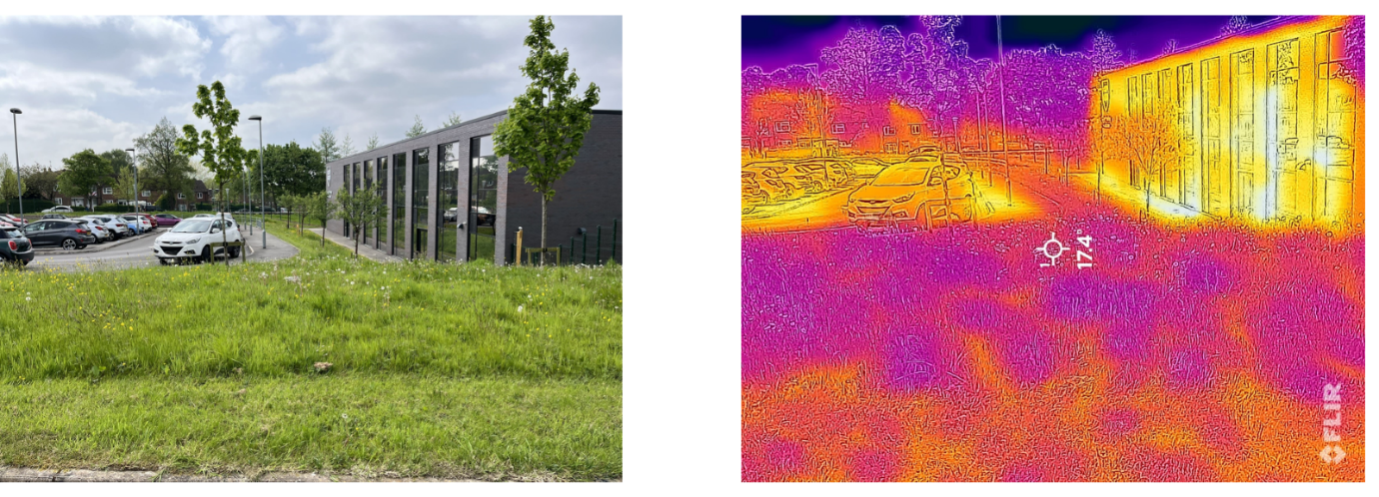
Car park
How do the different surfaces affect the temperature?
Co-op Academy Manchester, May 2024

Slide 7
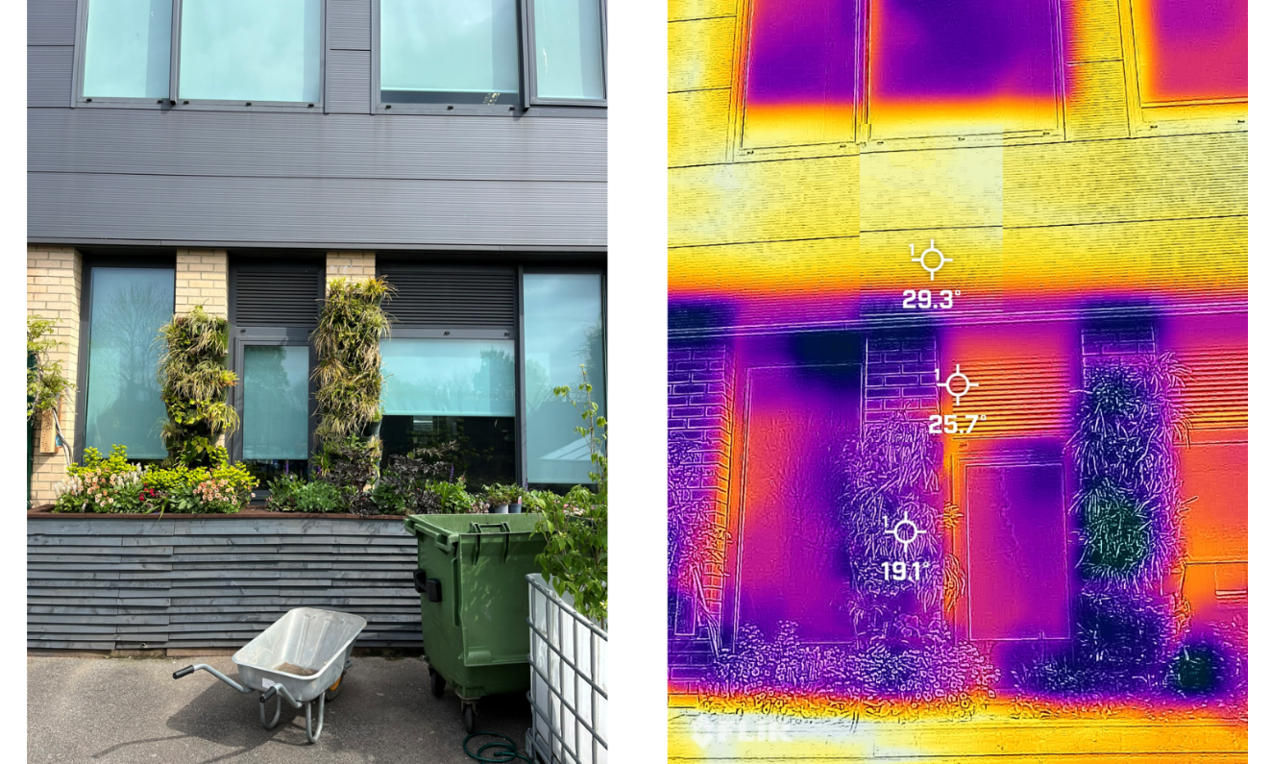
Green wall
What do you observe? Where is coolest and why?
Co-op Academy Manchester, May 2024

Slide 8
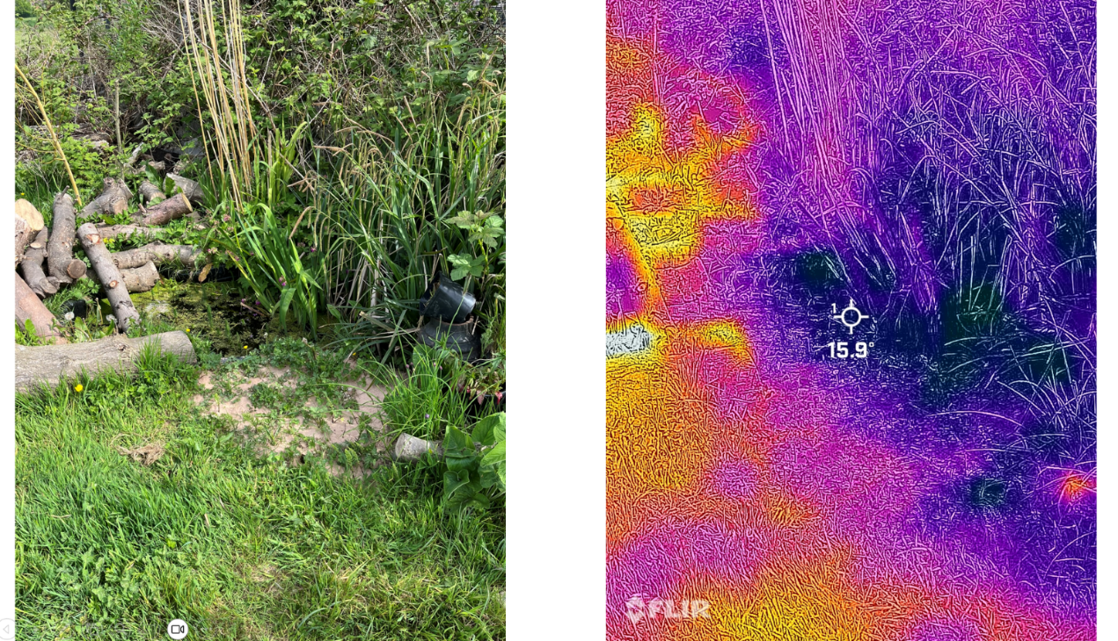
Small pond
What do you observe about the difference in temperatures?
Co-op Academy Manchester, May 2024

Slide 9
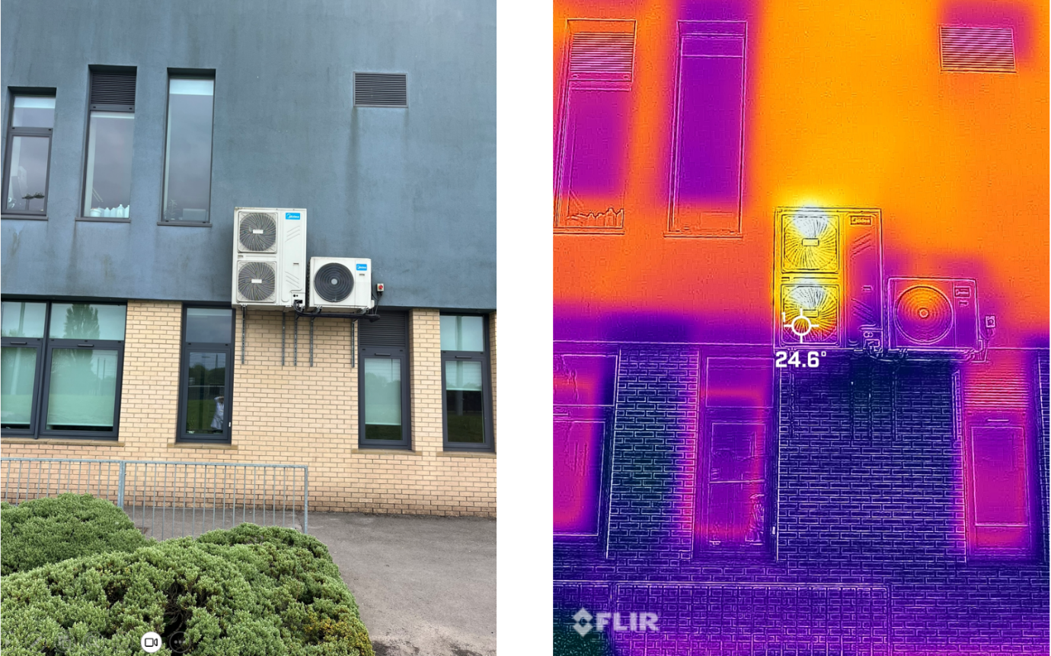
School wall with air conditioning
What do you observe about the difference in temperatures?
Co-op Academy, Manchester, May 2024

Slide 10
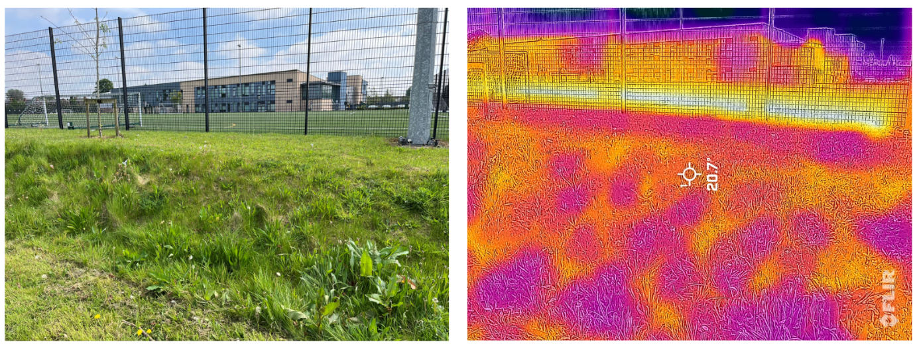
All weather pitch and grassed area
What do you observe about the temperatures?
Why do you think it is happening?
Co-op Academy, Manchester, May 2024

Slide 11
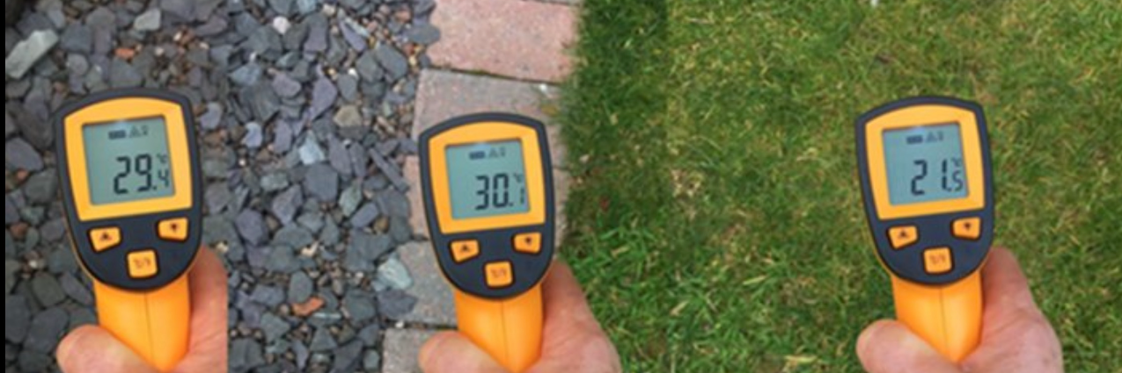
Temperature on different surfaces
How do temperatures of different surfaces in the same sunlight compare?

Slide 12
Why does our learning matter?
Why does this knowledge and understanding matter?
Why is it useful in our everyday lives?

